Slide 1

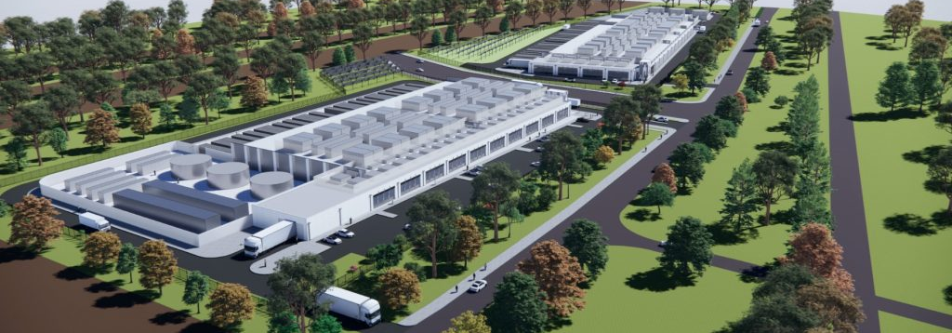

Maps of purified recycled water for drinking (potable reuse)
WSAA March 2026

Slide 2
This deck contains
Purified recycled water for drinking maps as PNGs:
  Master
  Timeline of purified recycled water since 1960s
  Maps by stage: Exploring/Education, Planned, In Construction, Operating/Available
  Maps by augmentation type: Groundwater, Reservoir, Raw, Treated, Other/TBC
  Indirect & direct
  USA only
Please see the powerpoint presentation for an outline of what the maps cover, useful charts, graphs and key messages.

Slide 3
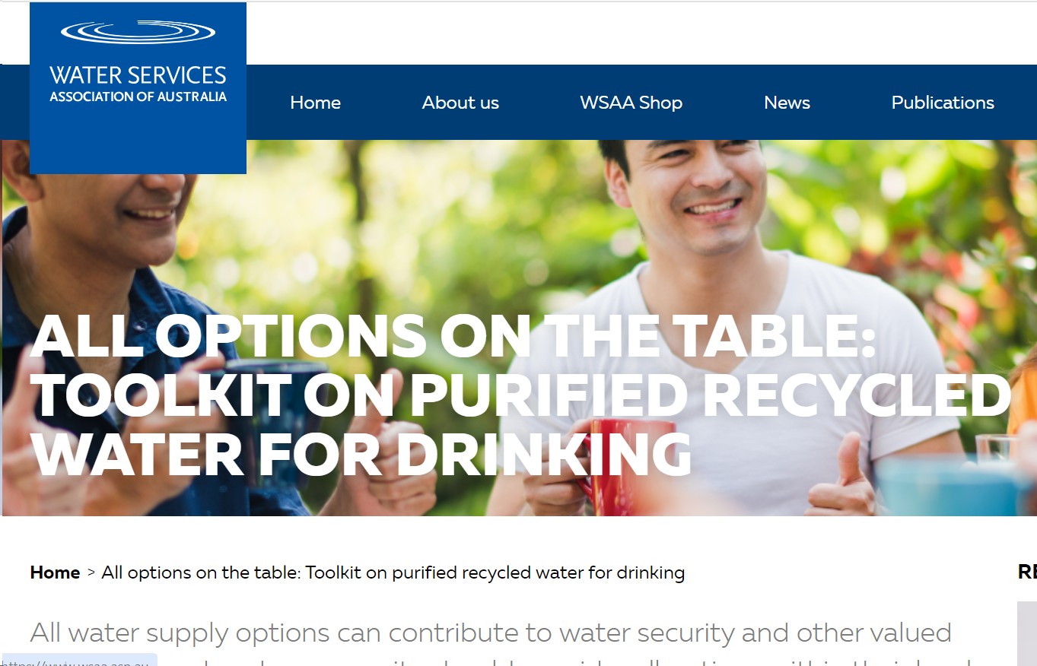
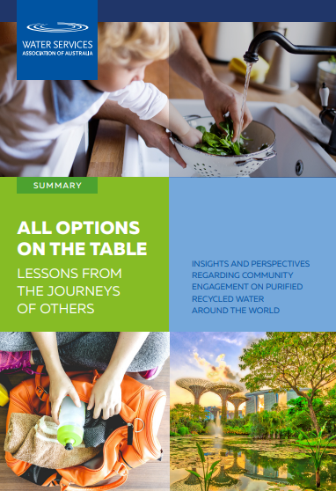

Other useful education resources
Purified recycled water maps & education resources: www.water360.com.au
PRW Toolkit: www.water360.com.au

Slide 4
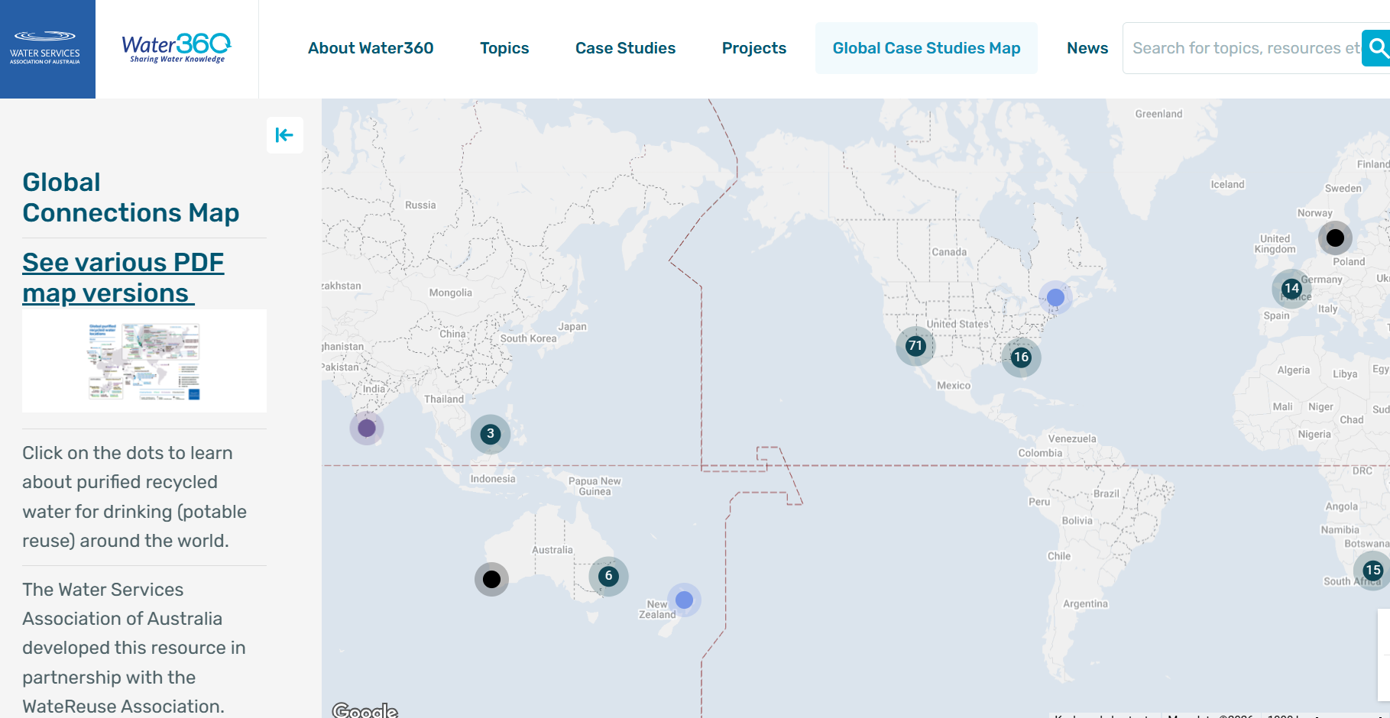
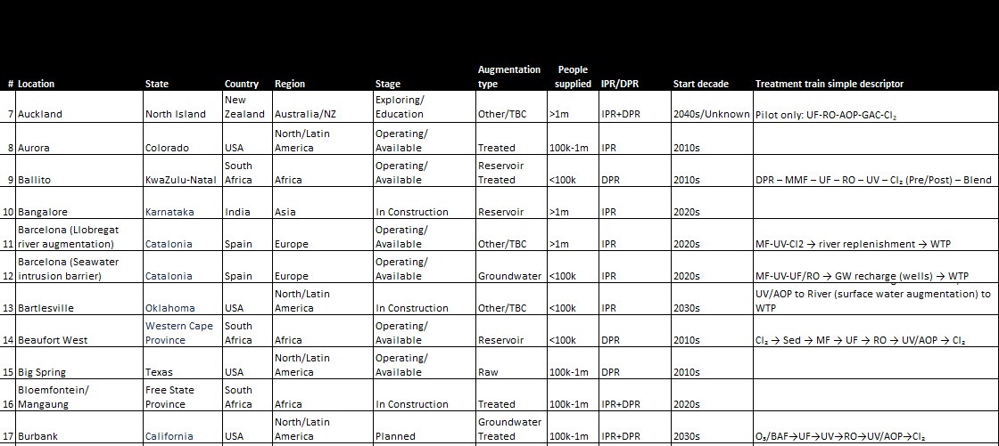
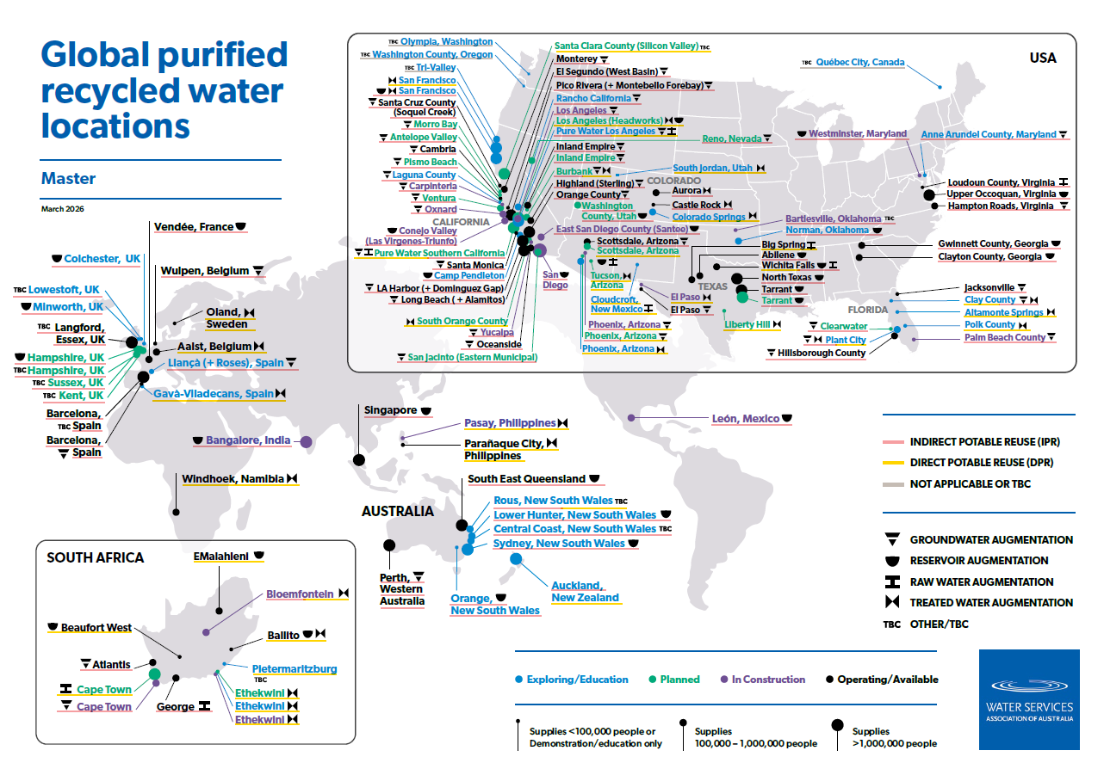
Maps created in 2024. 3 formats:
Interactive format
Table format
2026 is their 3rd iteration
Still format

Slide 5
Master map

Slide 6
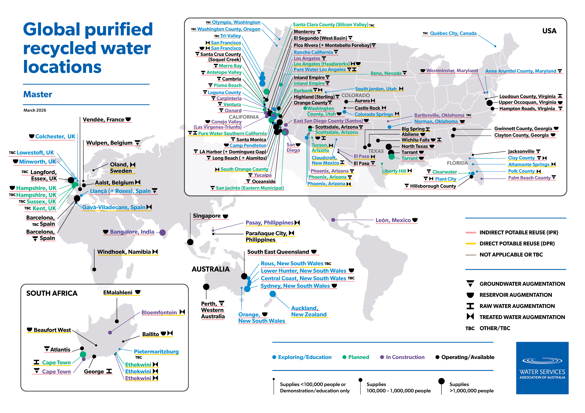

Slide 7
Timeline since 1960s

Slide 8
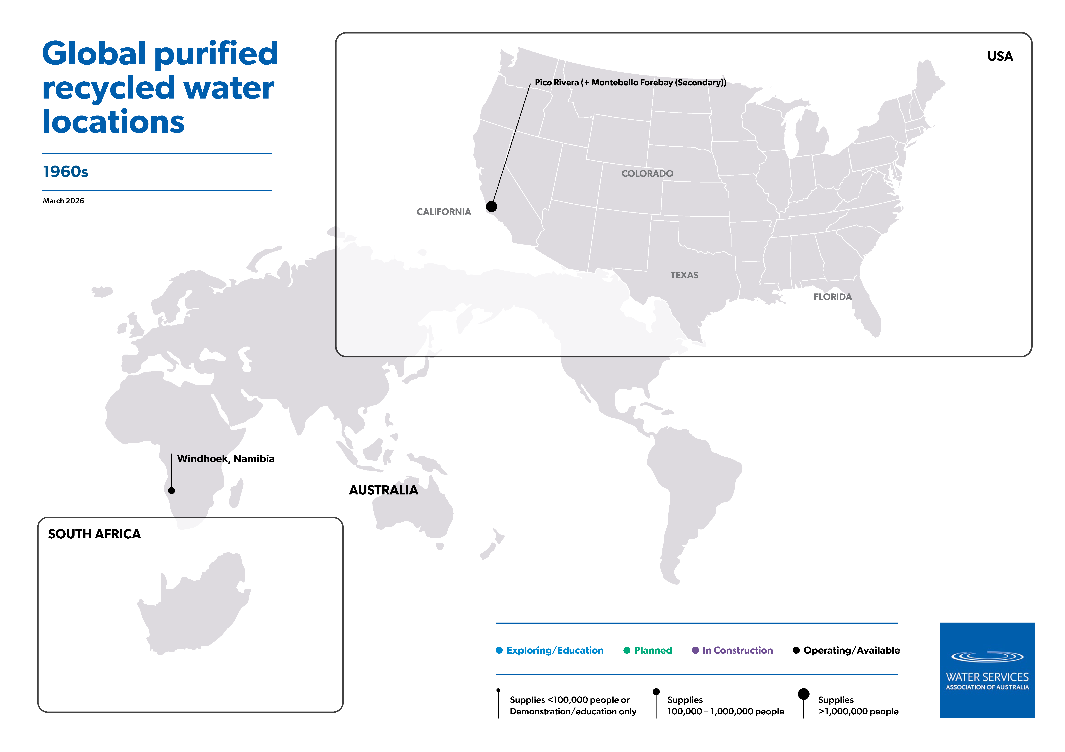

Slide 9


Slide 10
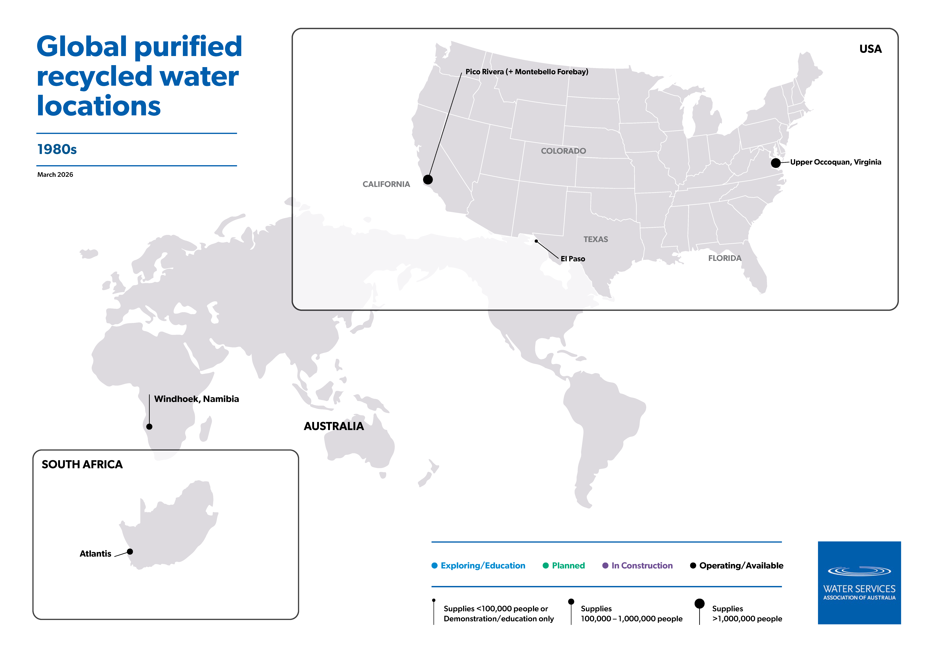

Slide 11


Slide 12
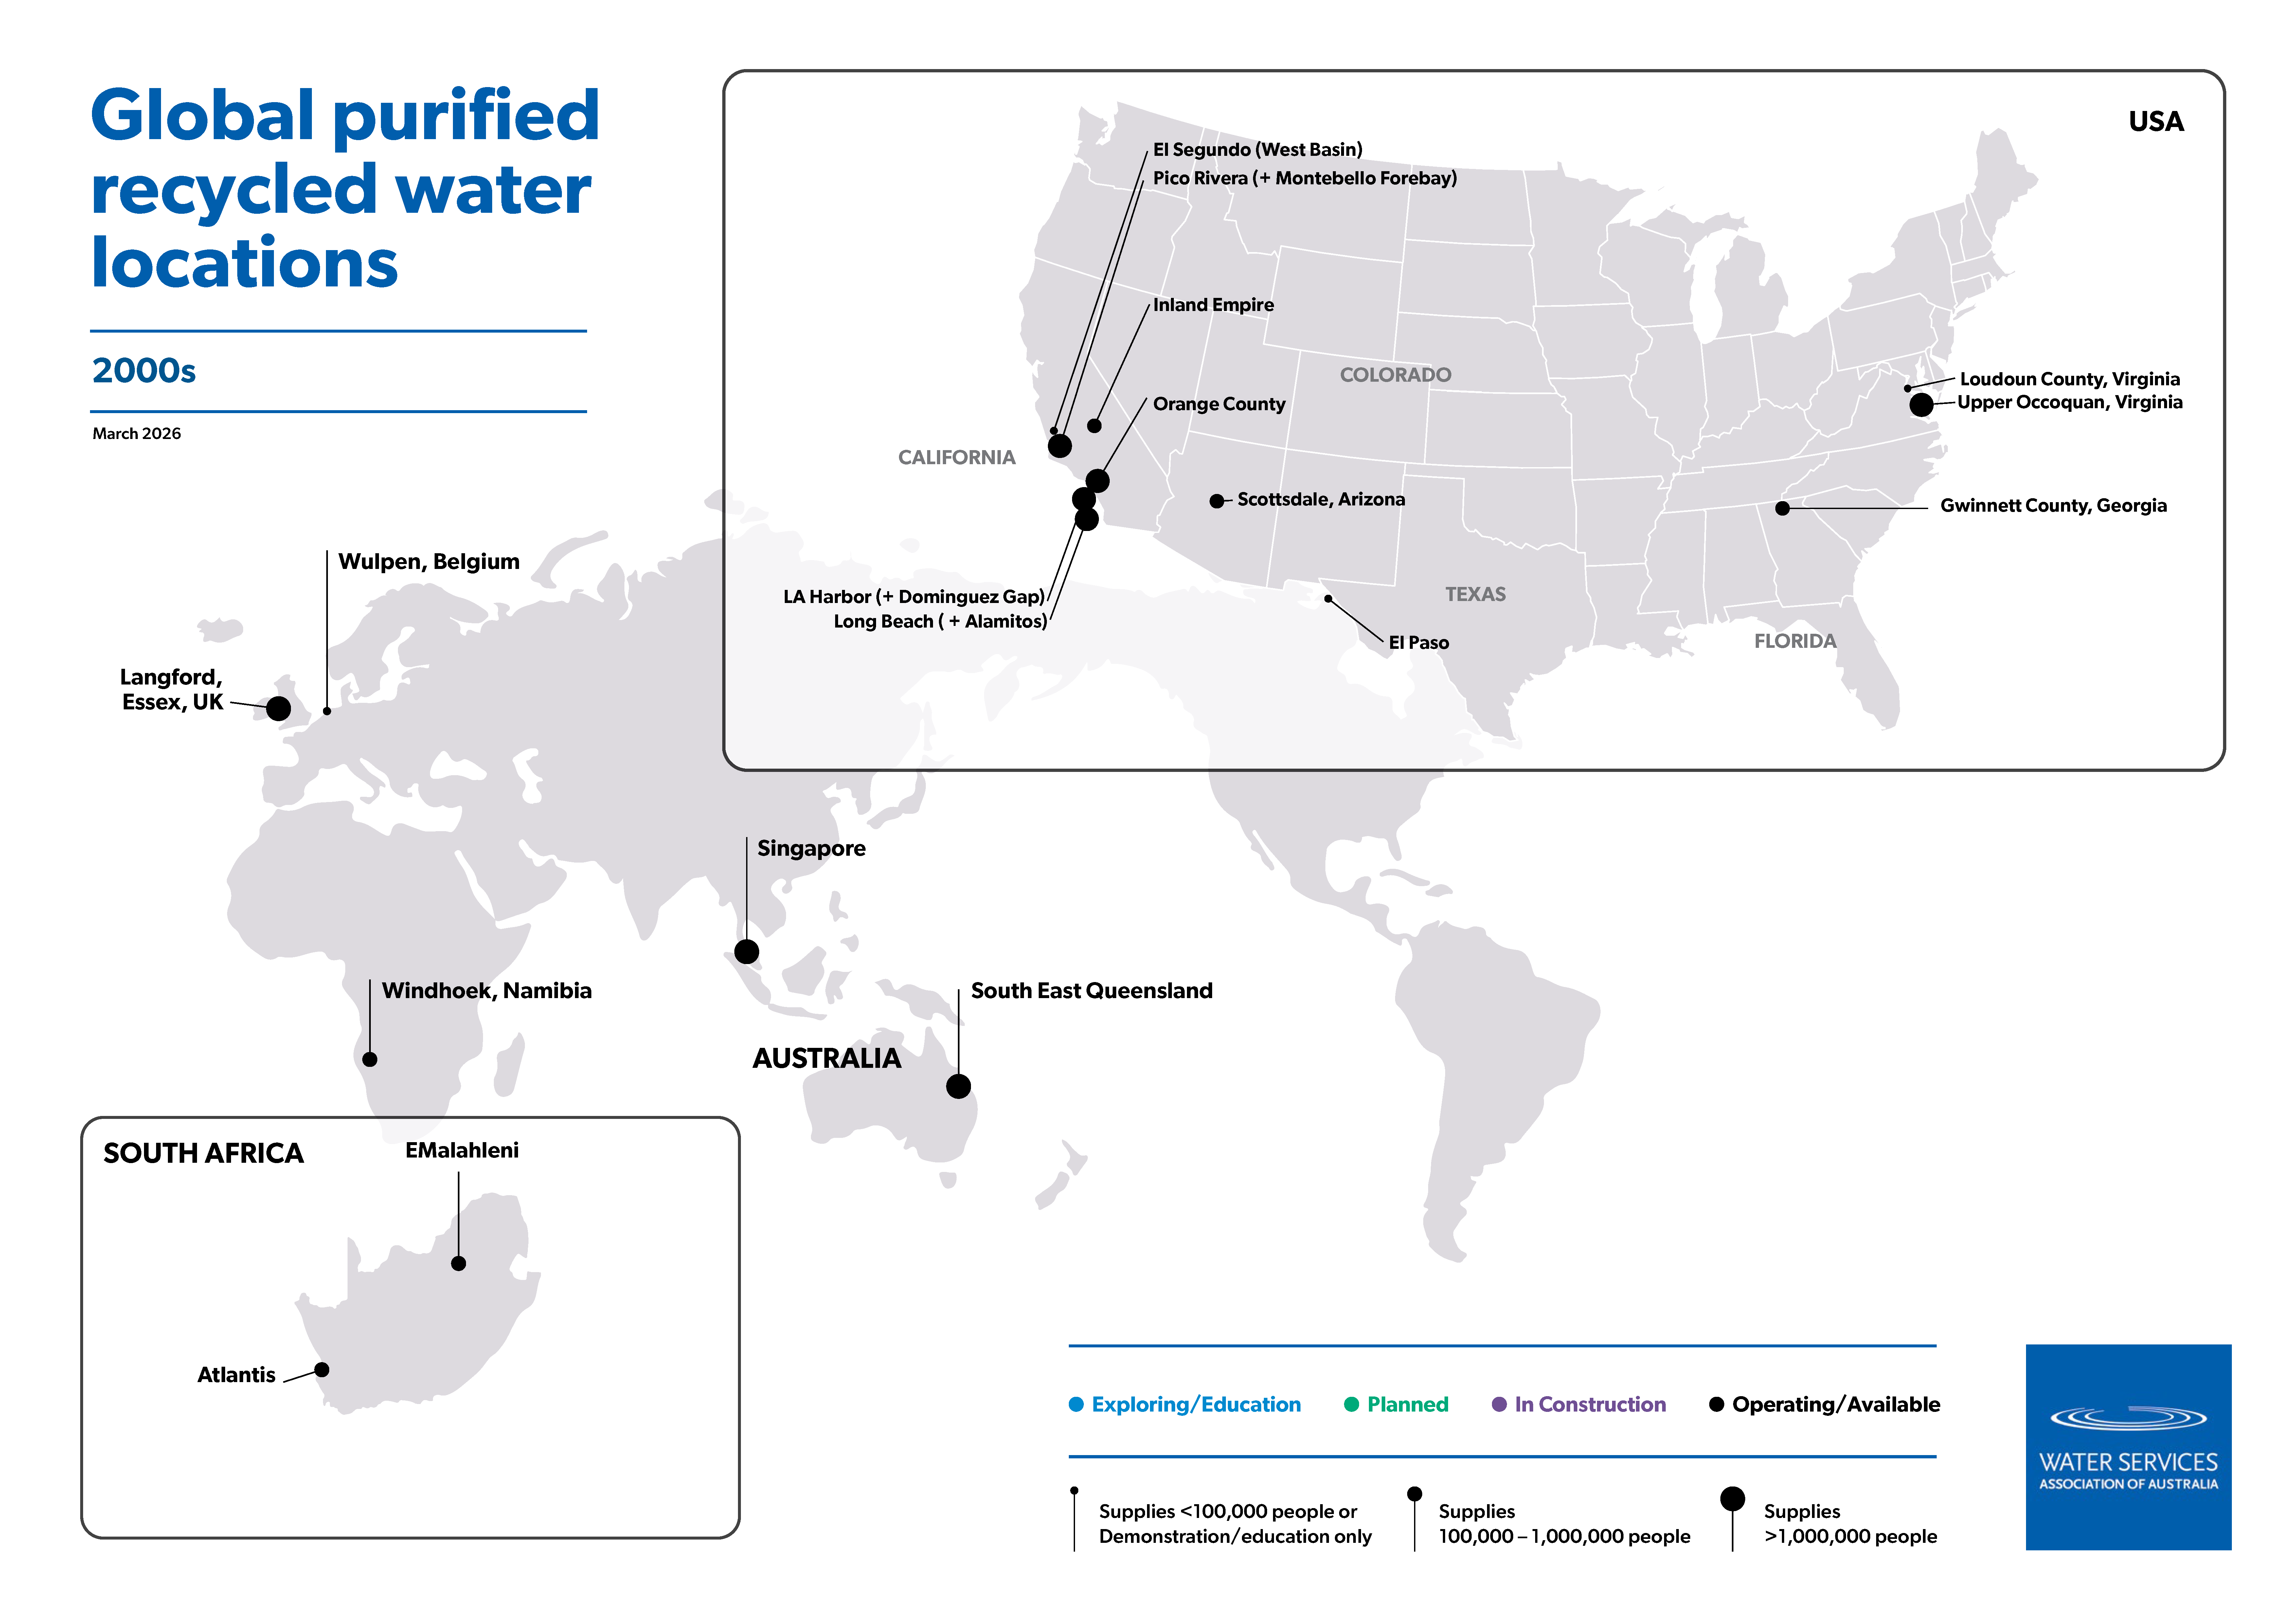

Slide 13
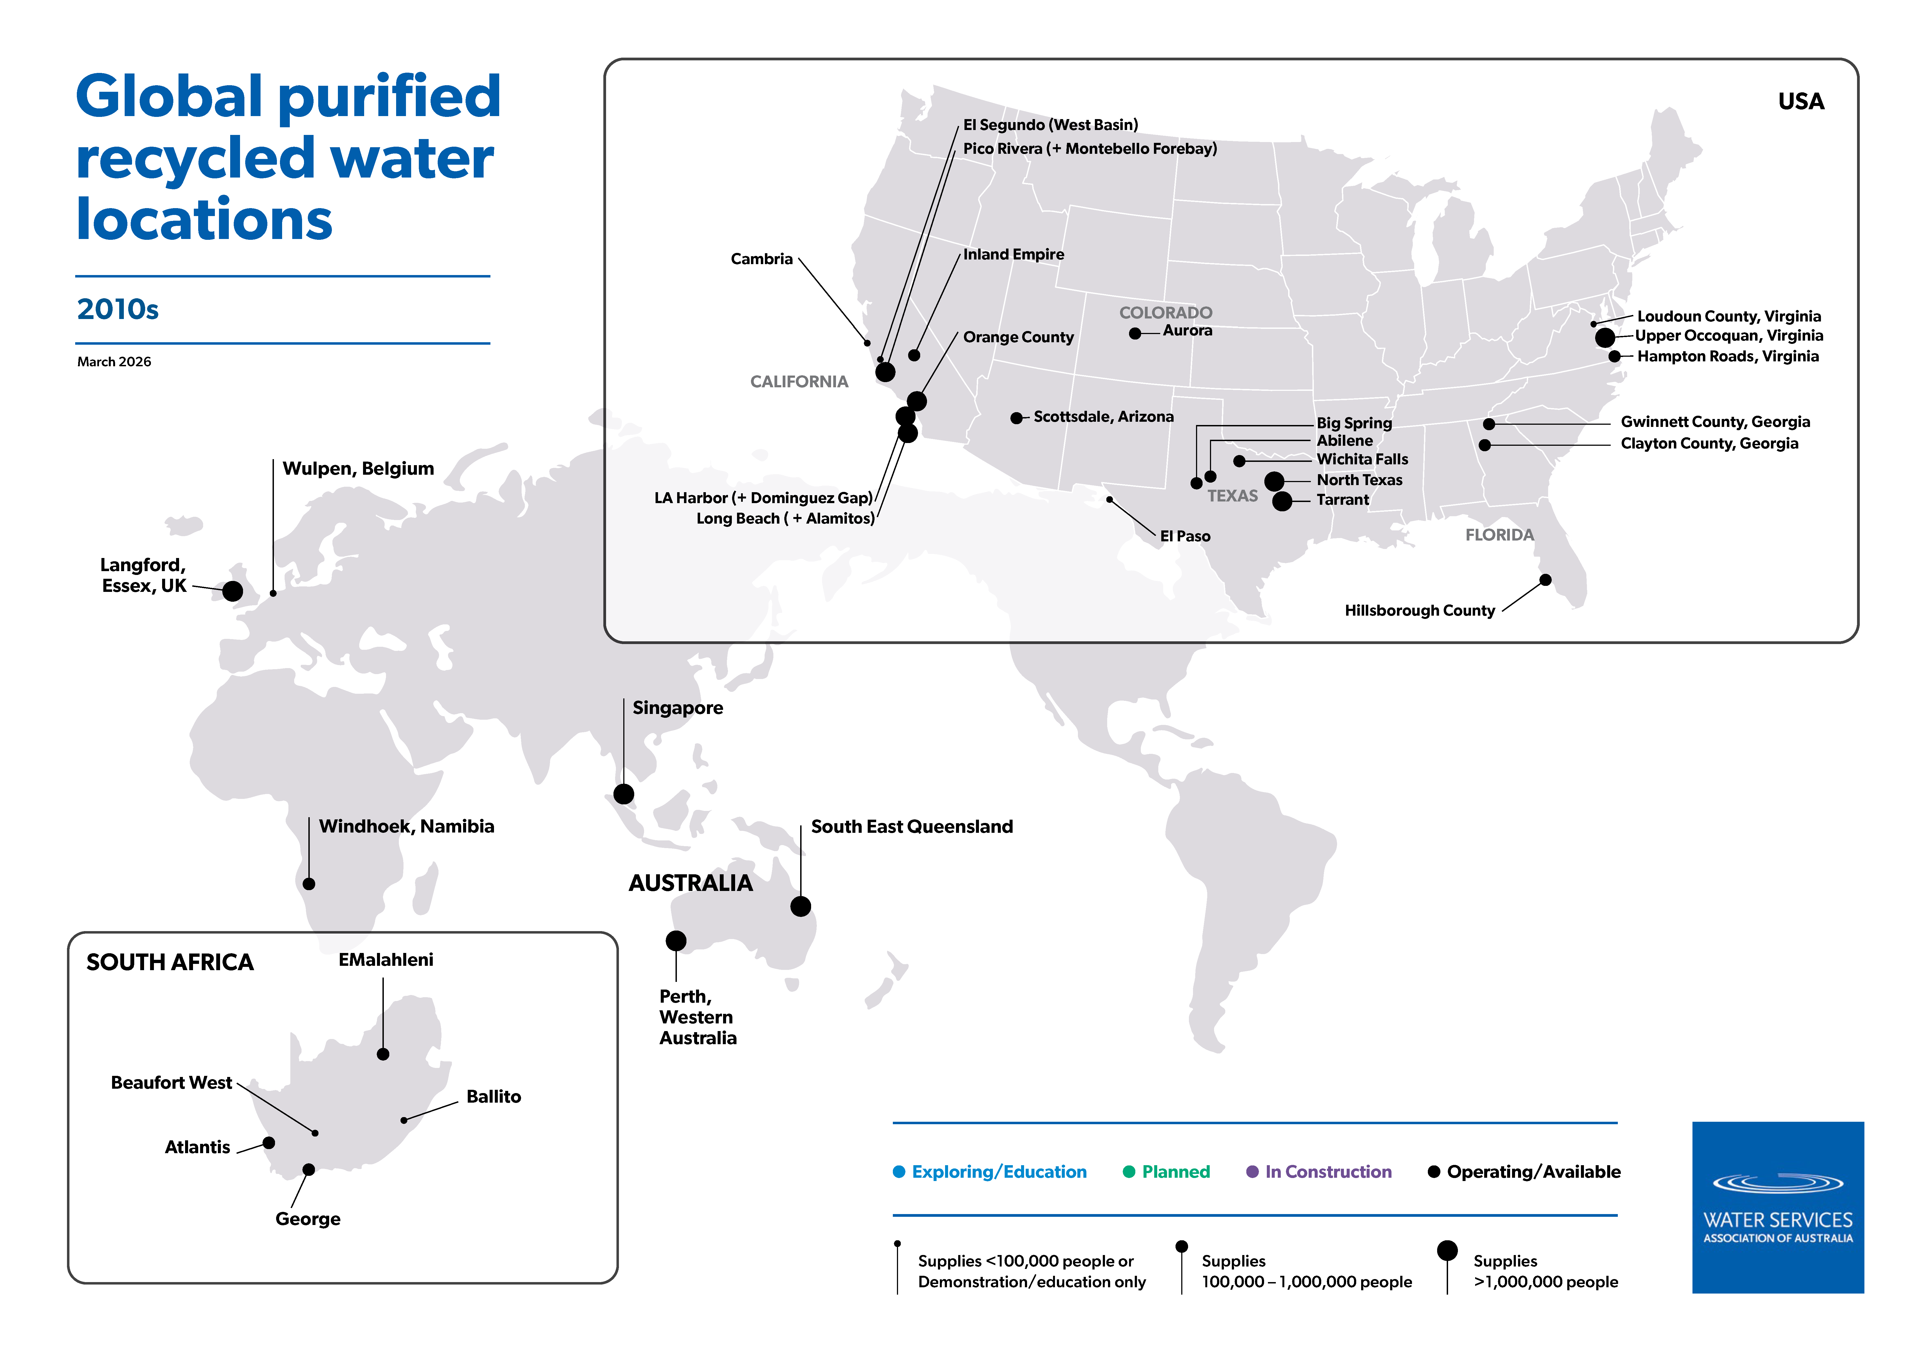

Slide 14
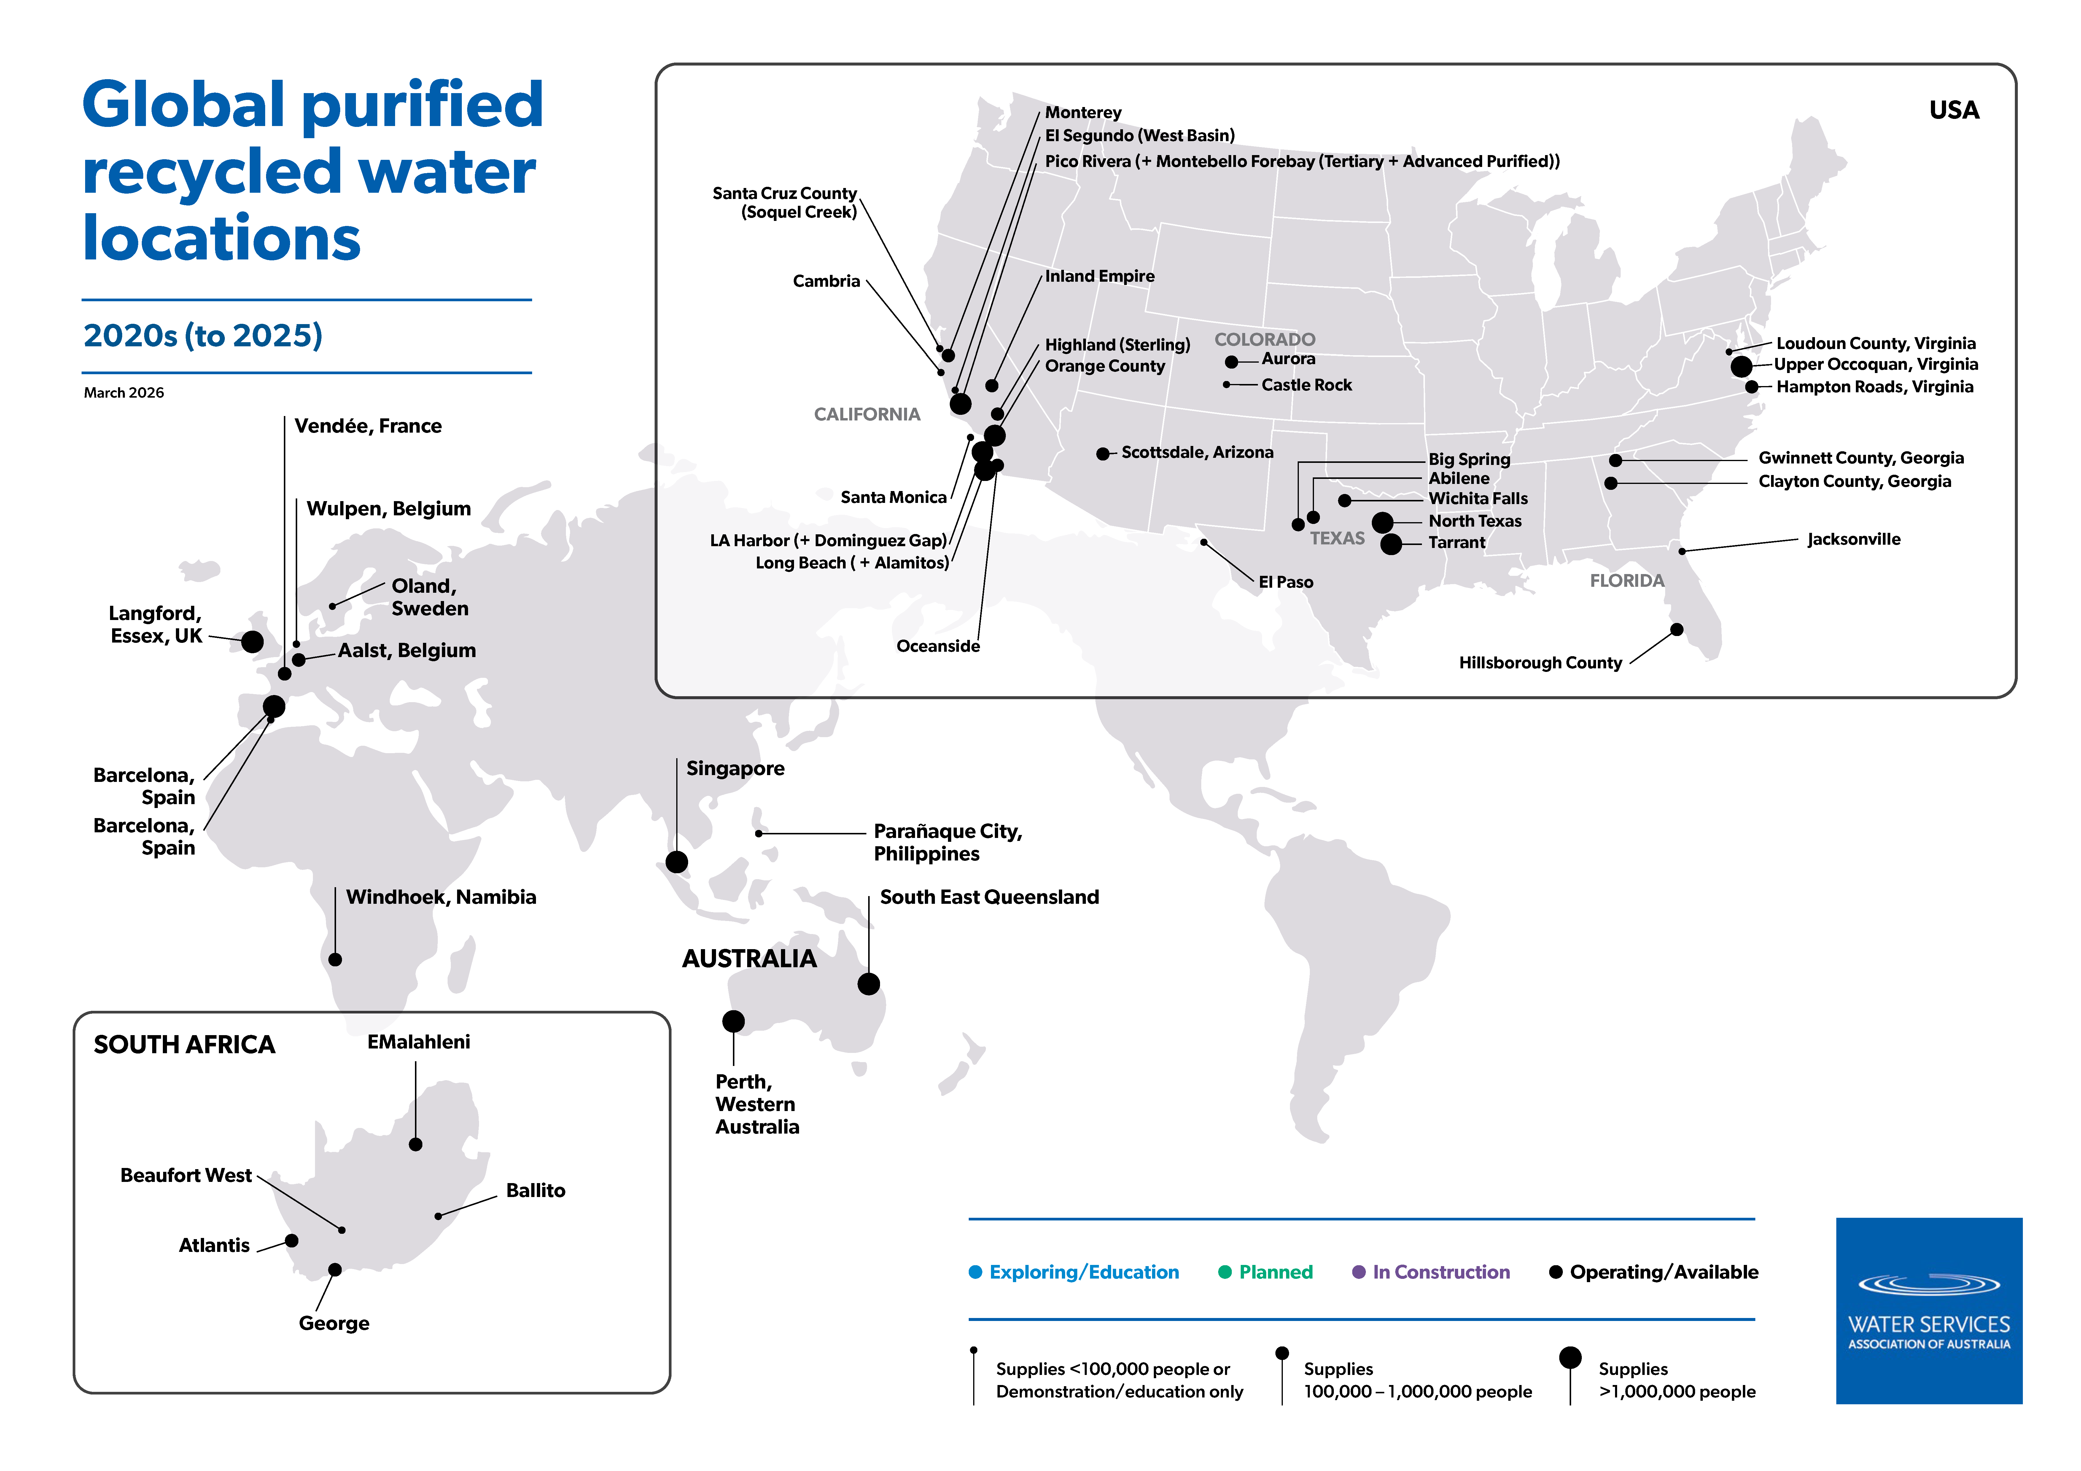

Slide 15
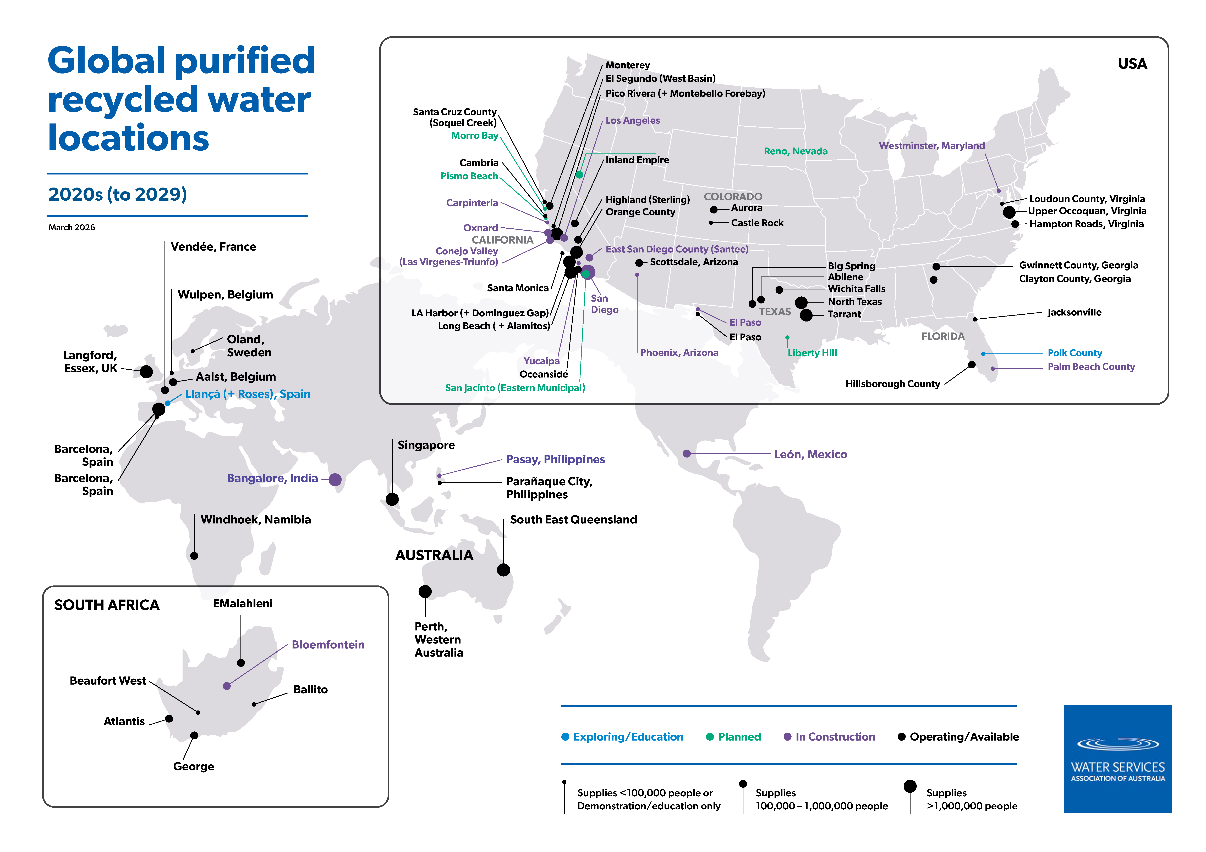

Slide 16
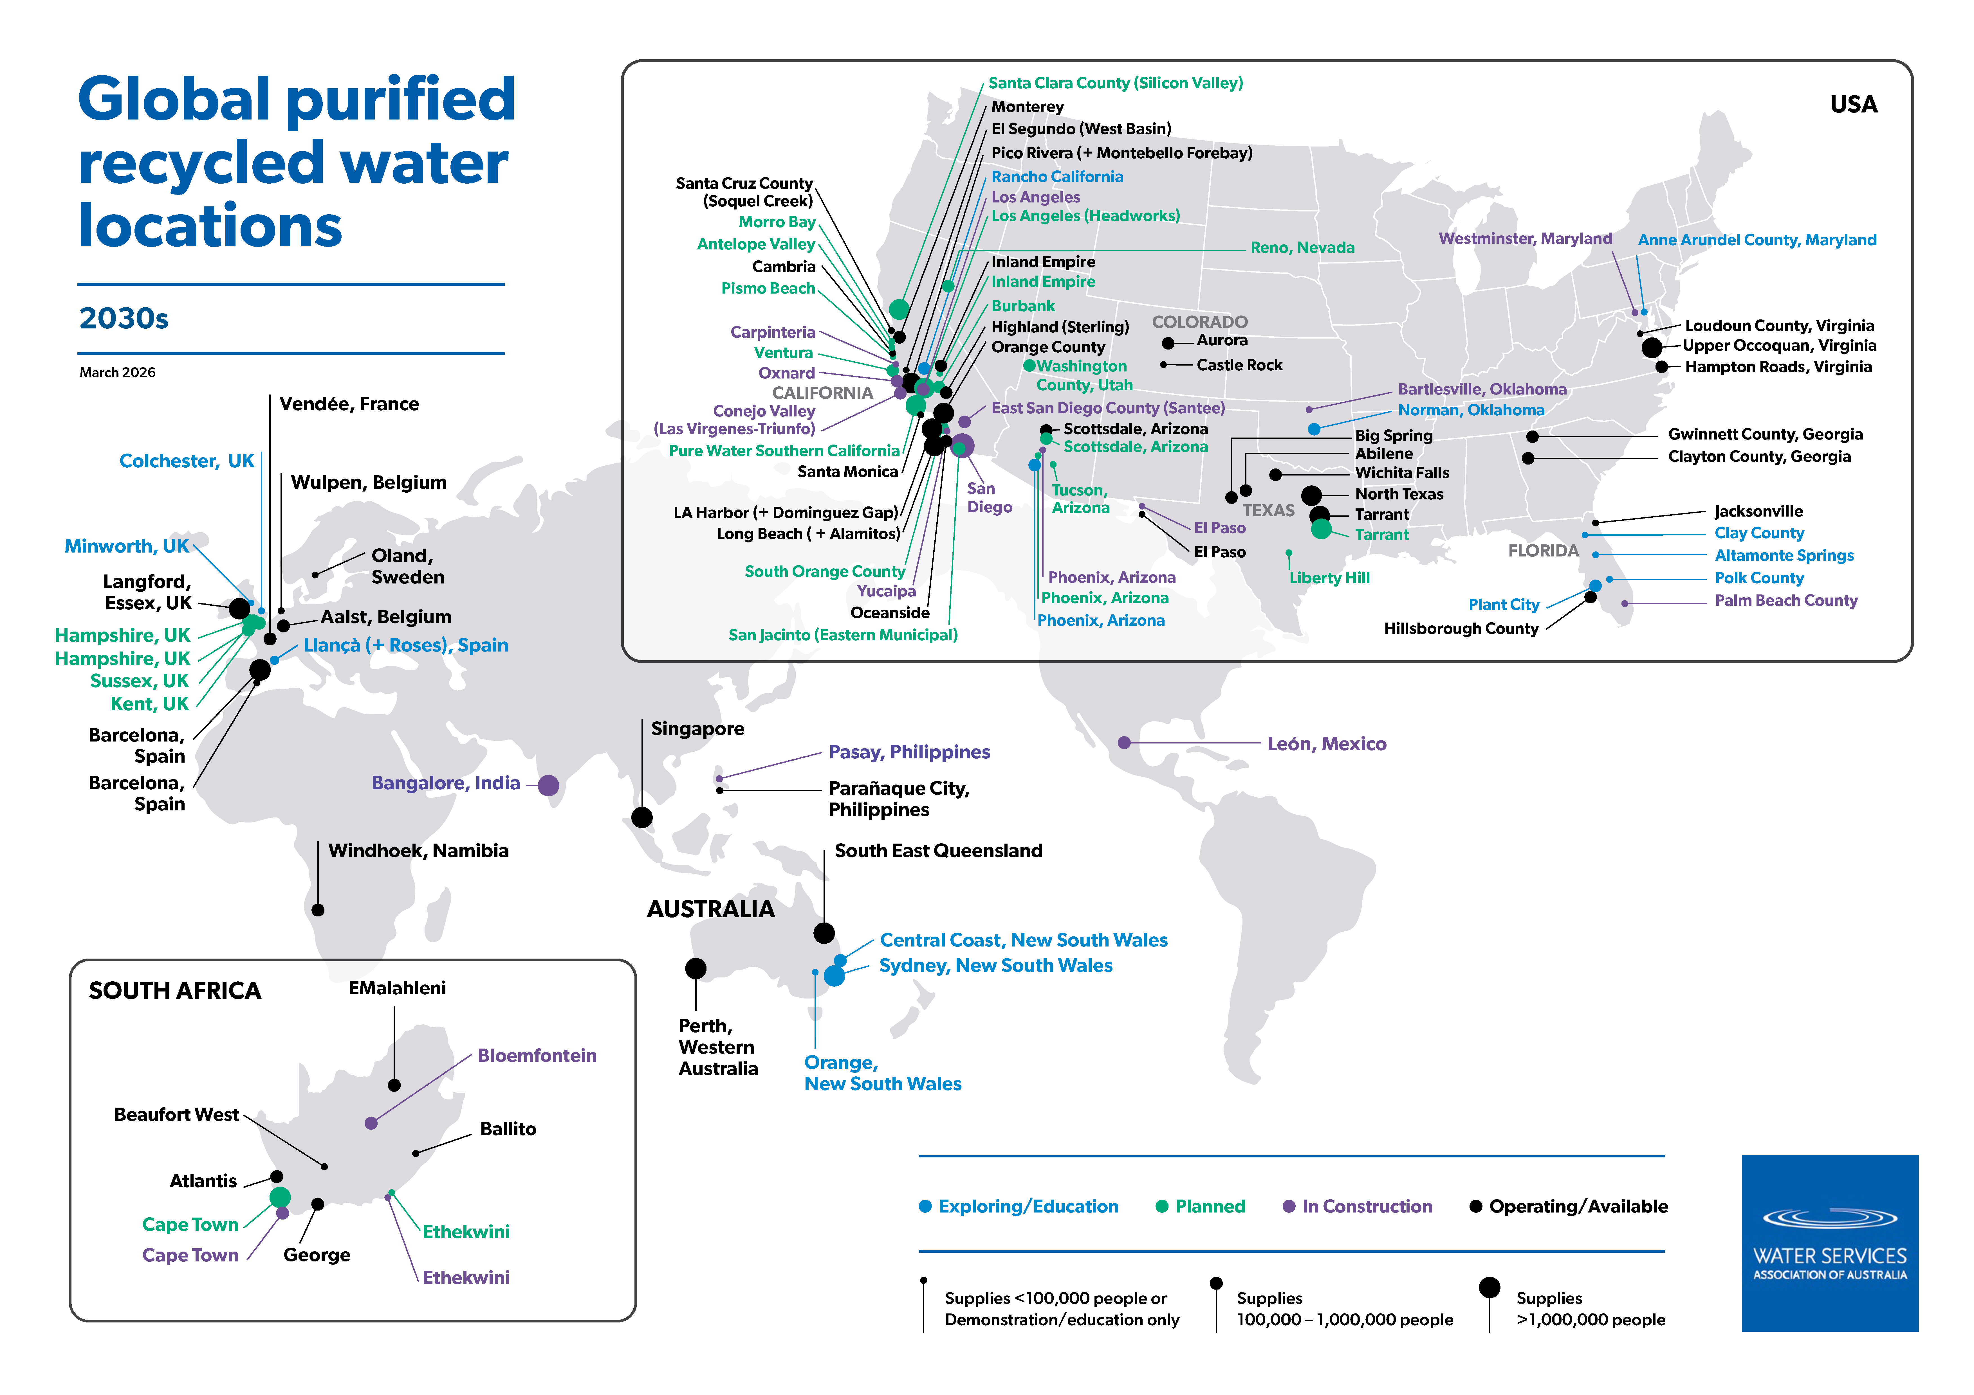

Slide 17
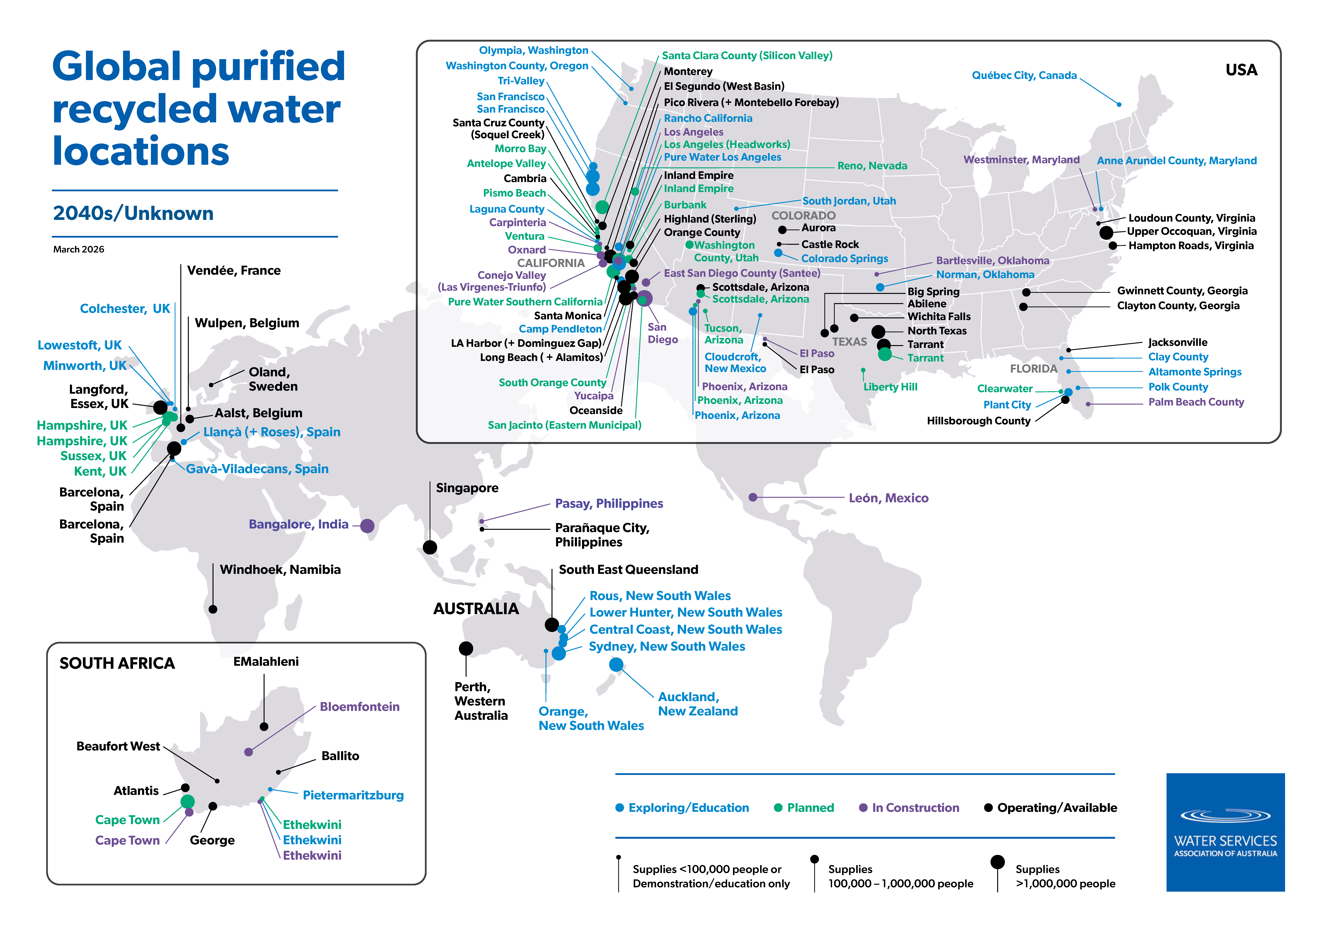

Slide 18
Maps by stage

Slide 19
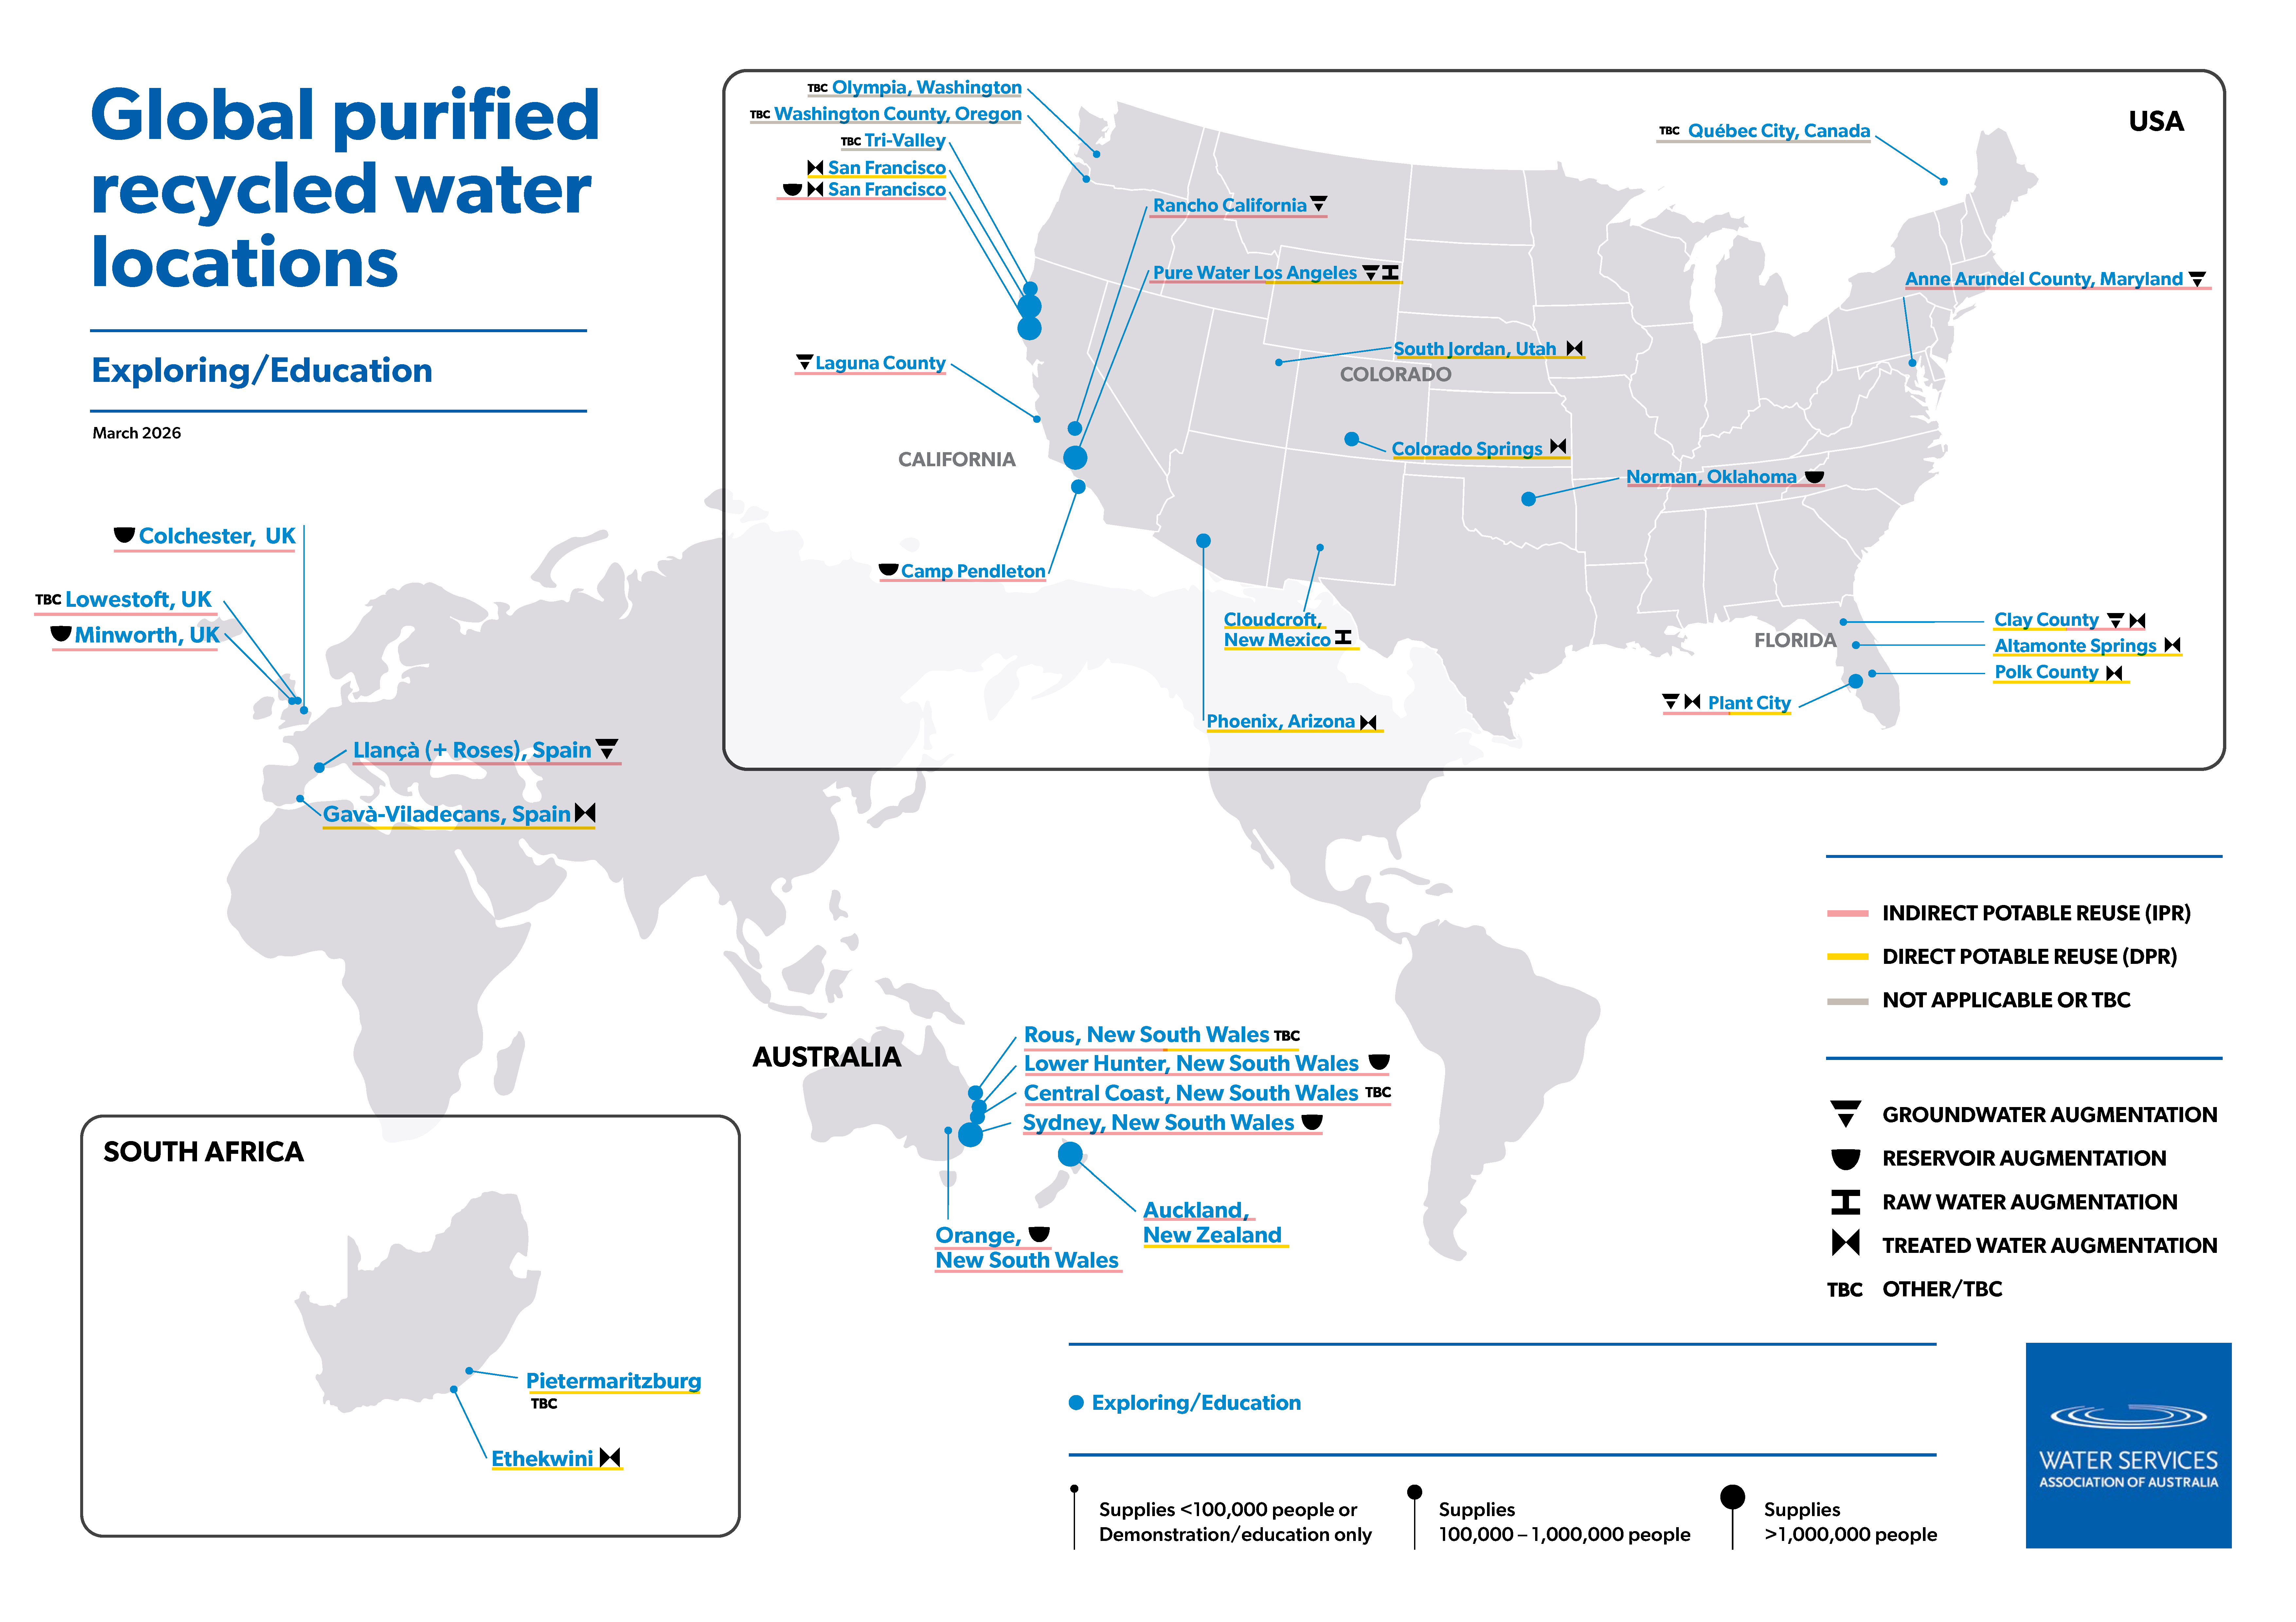

Slide 20
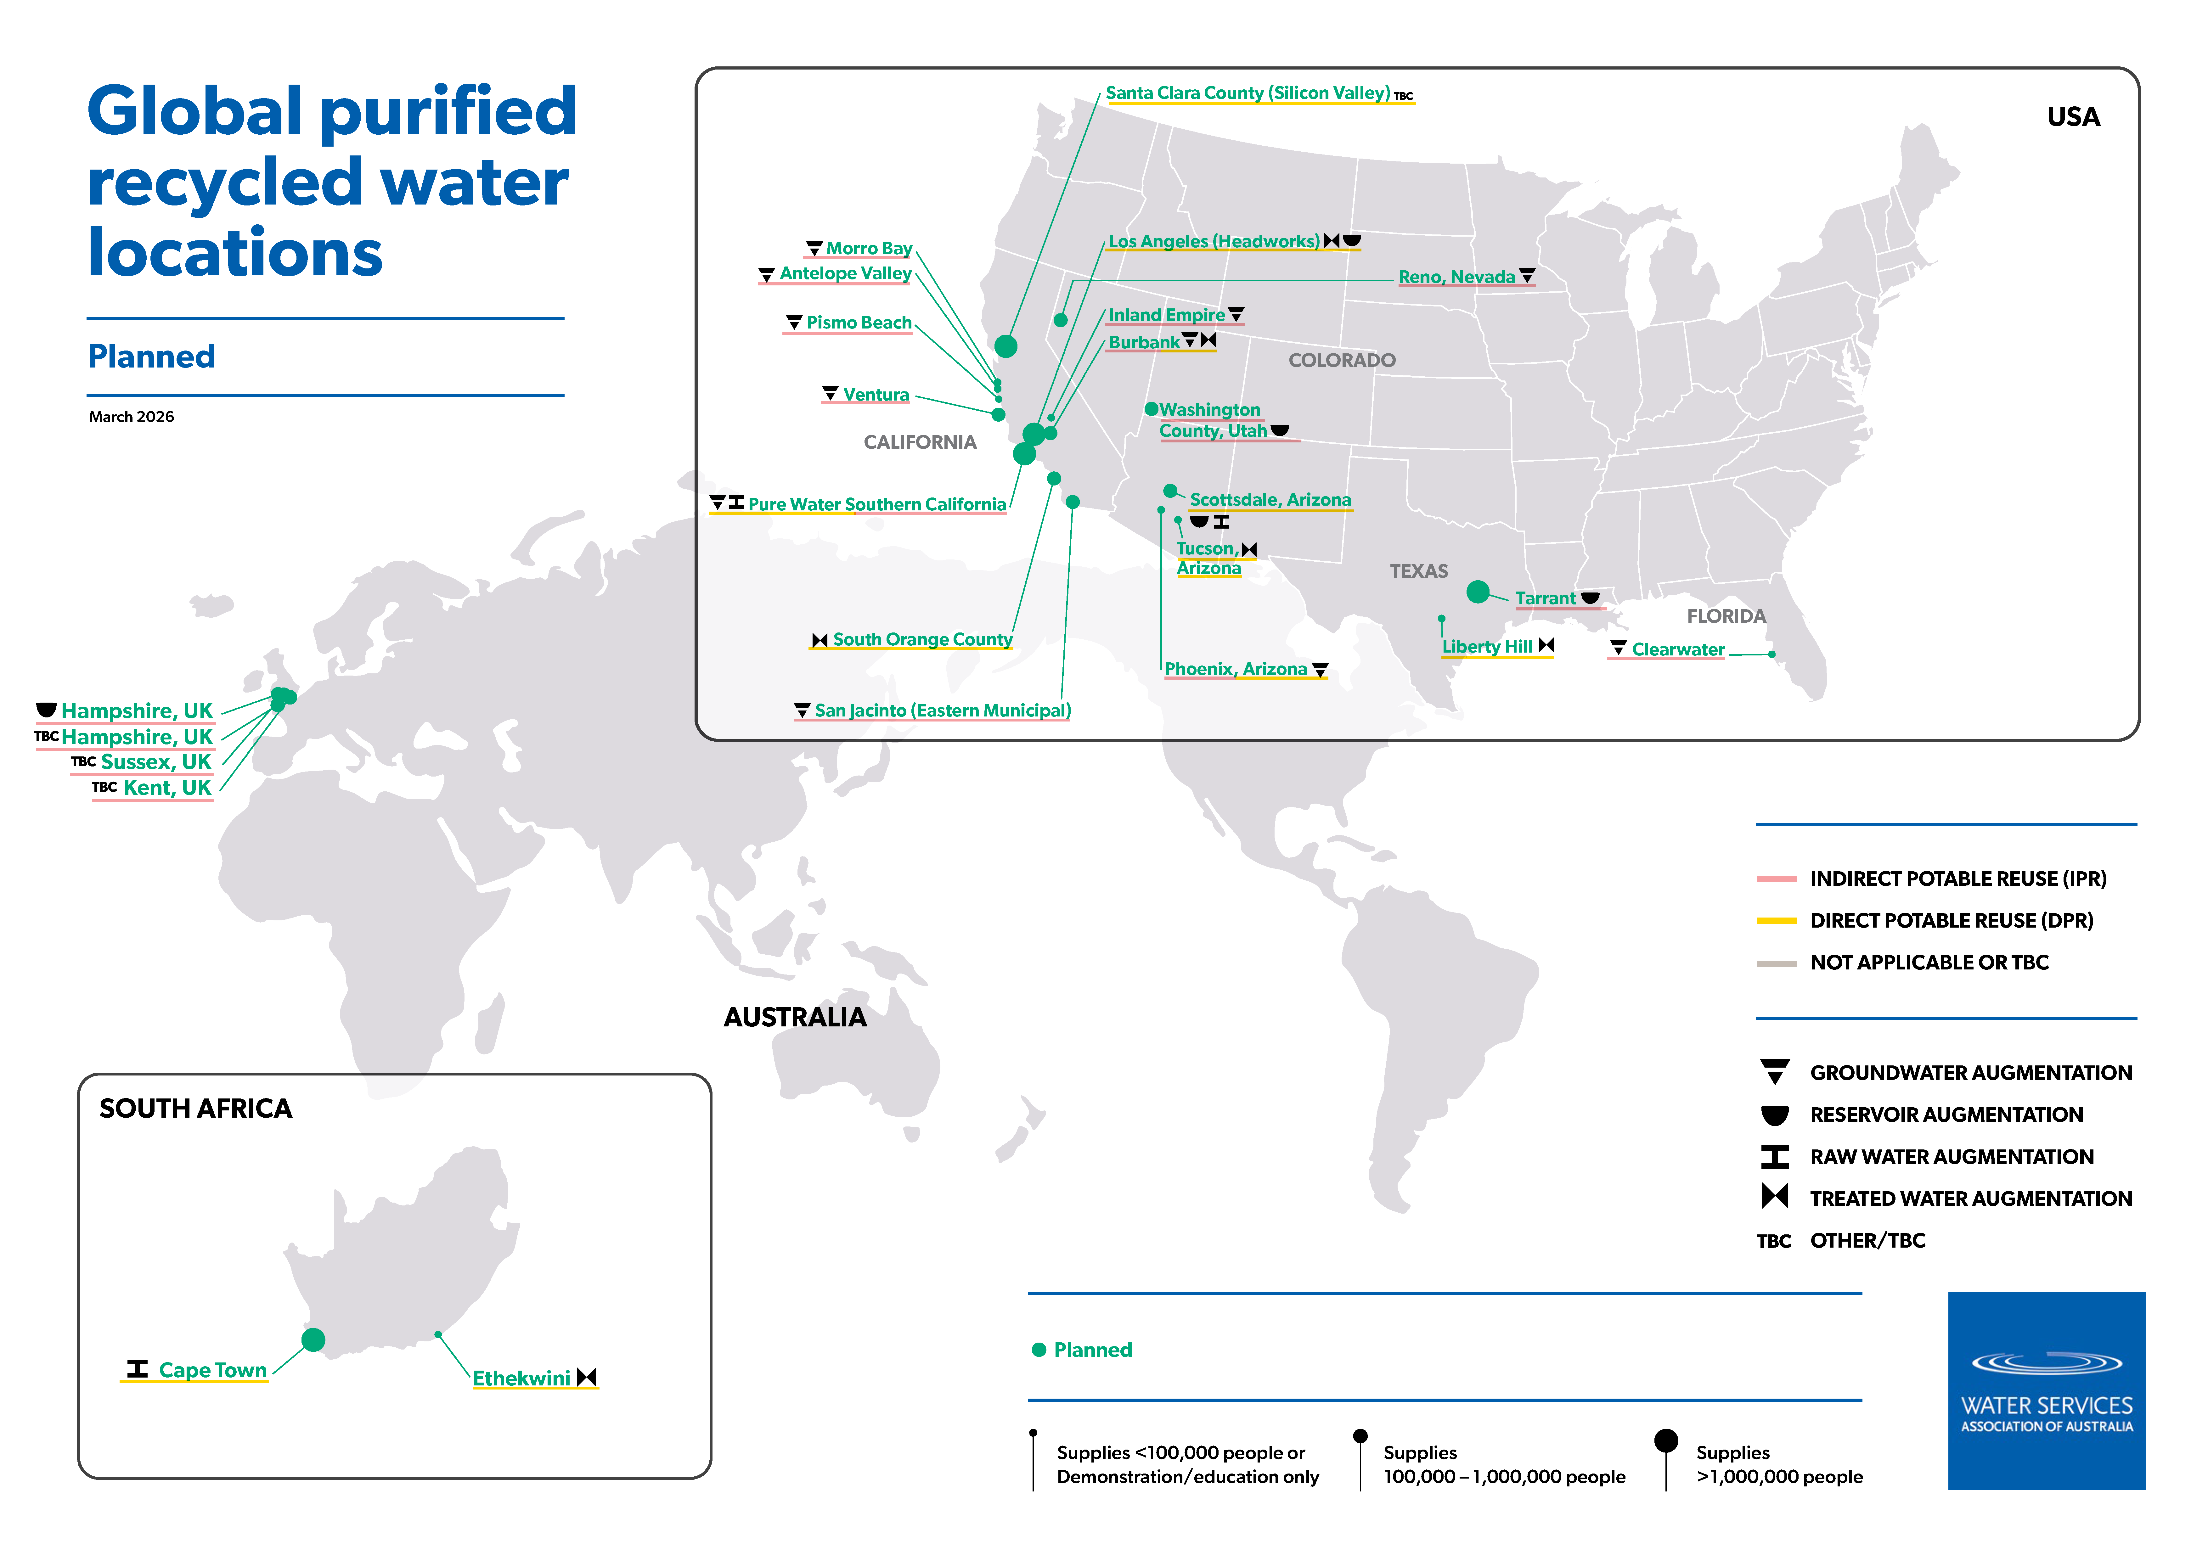

Slide 21
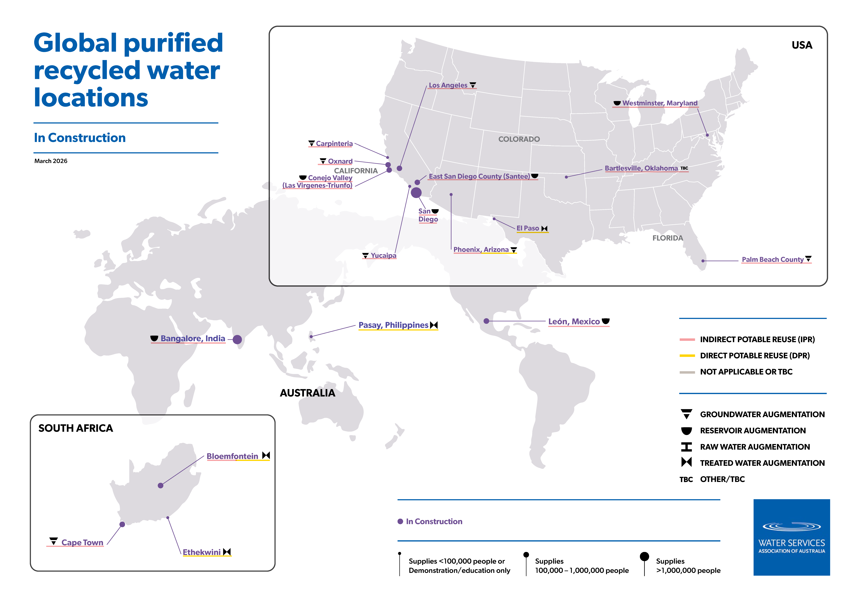

Slide 22
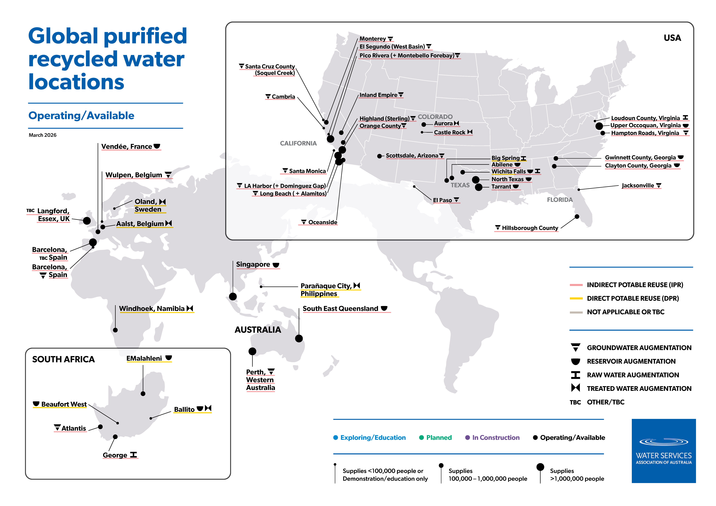

Slide 23
Maps by augmentation type

Slide 24
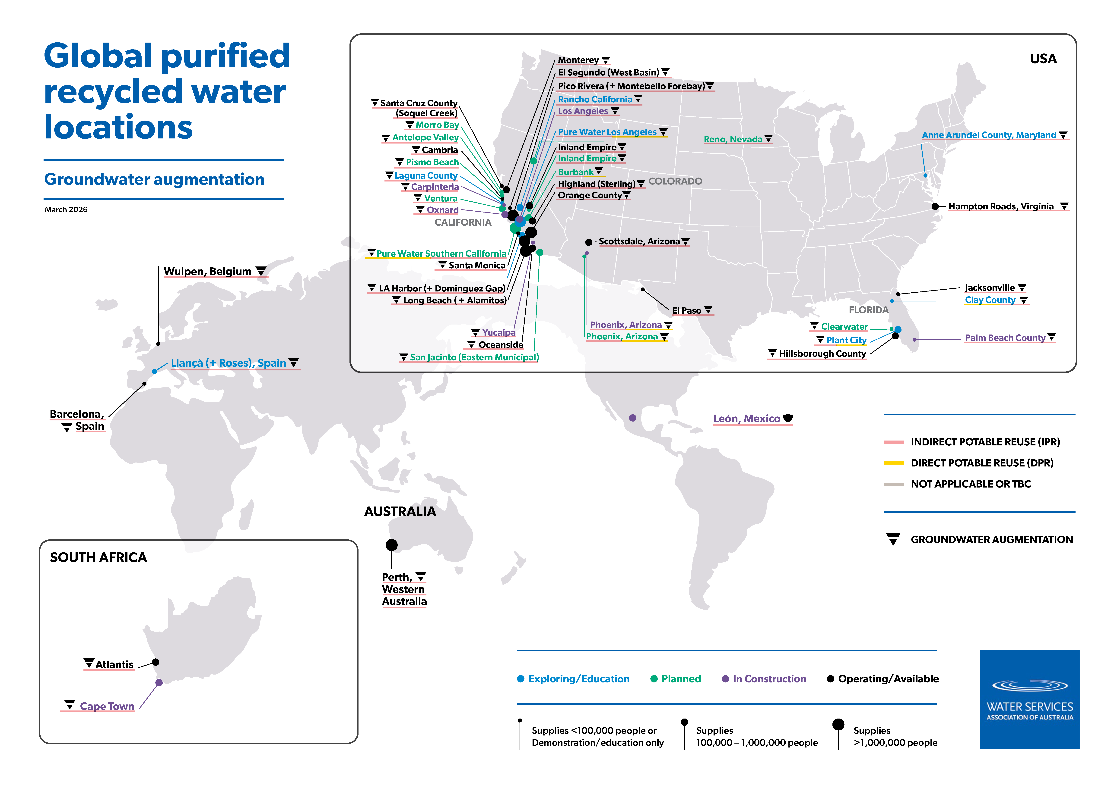

Slide 25
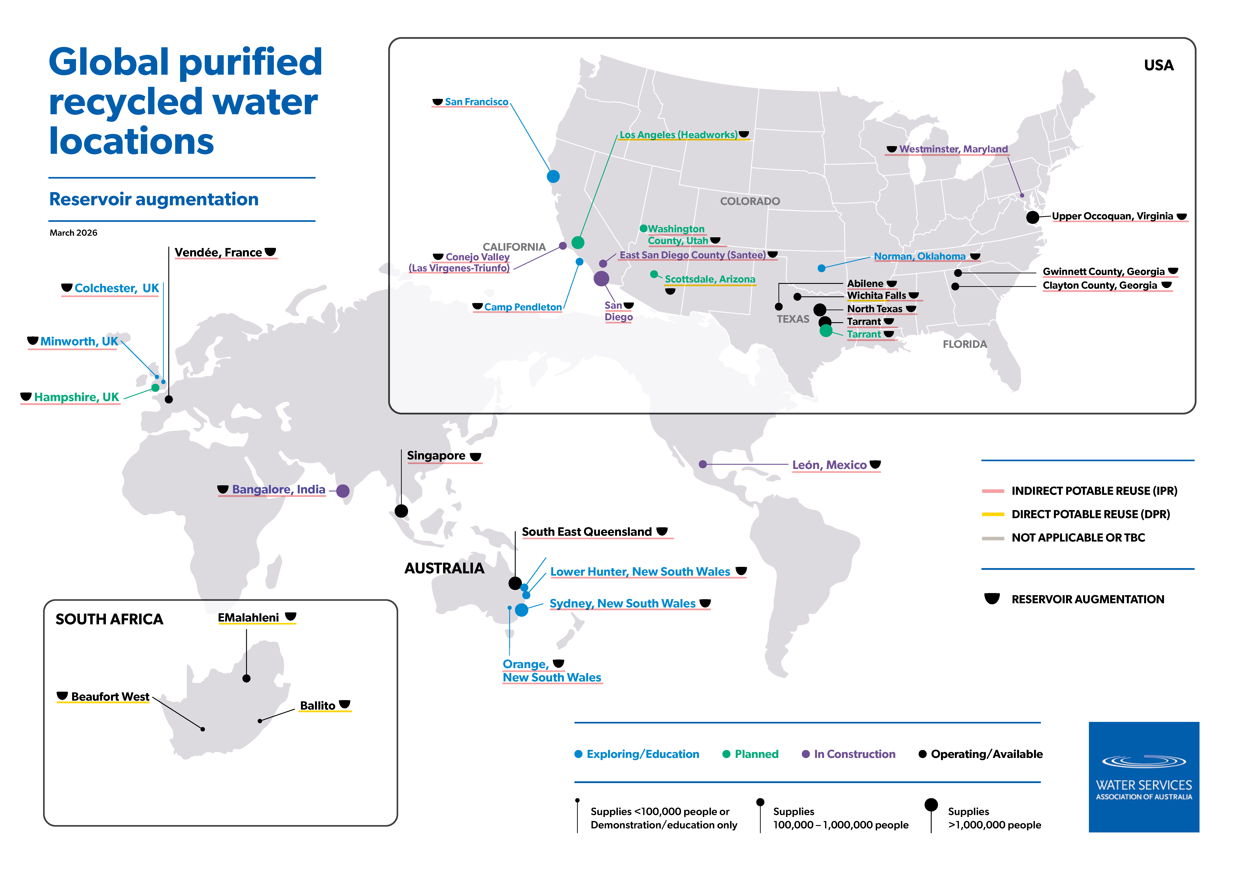

Slide 26
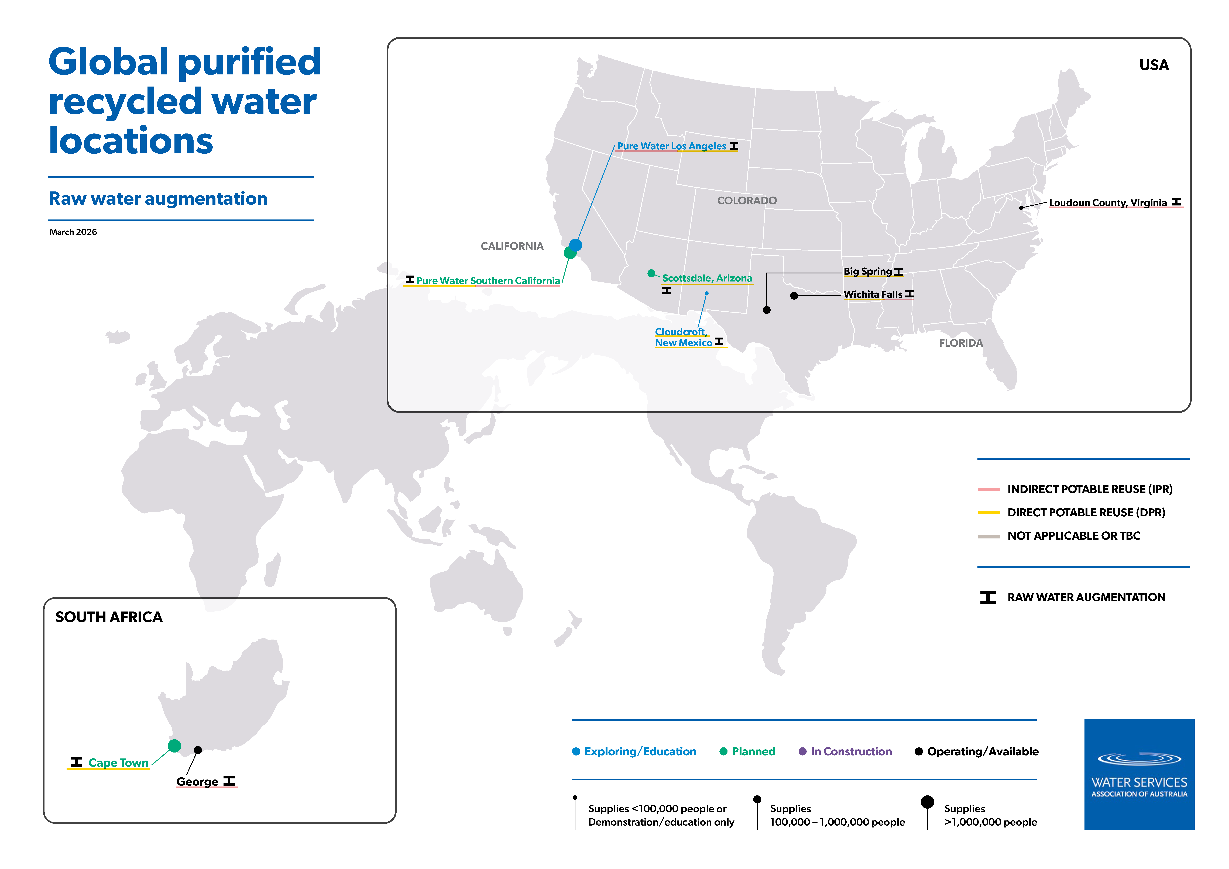

Slide 27
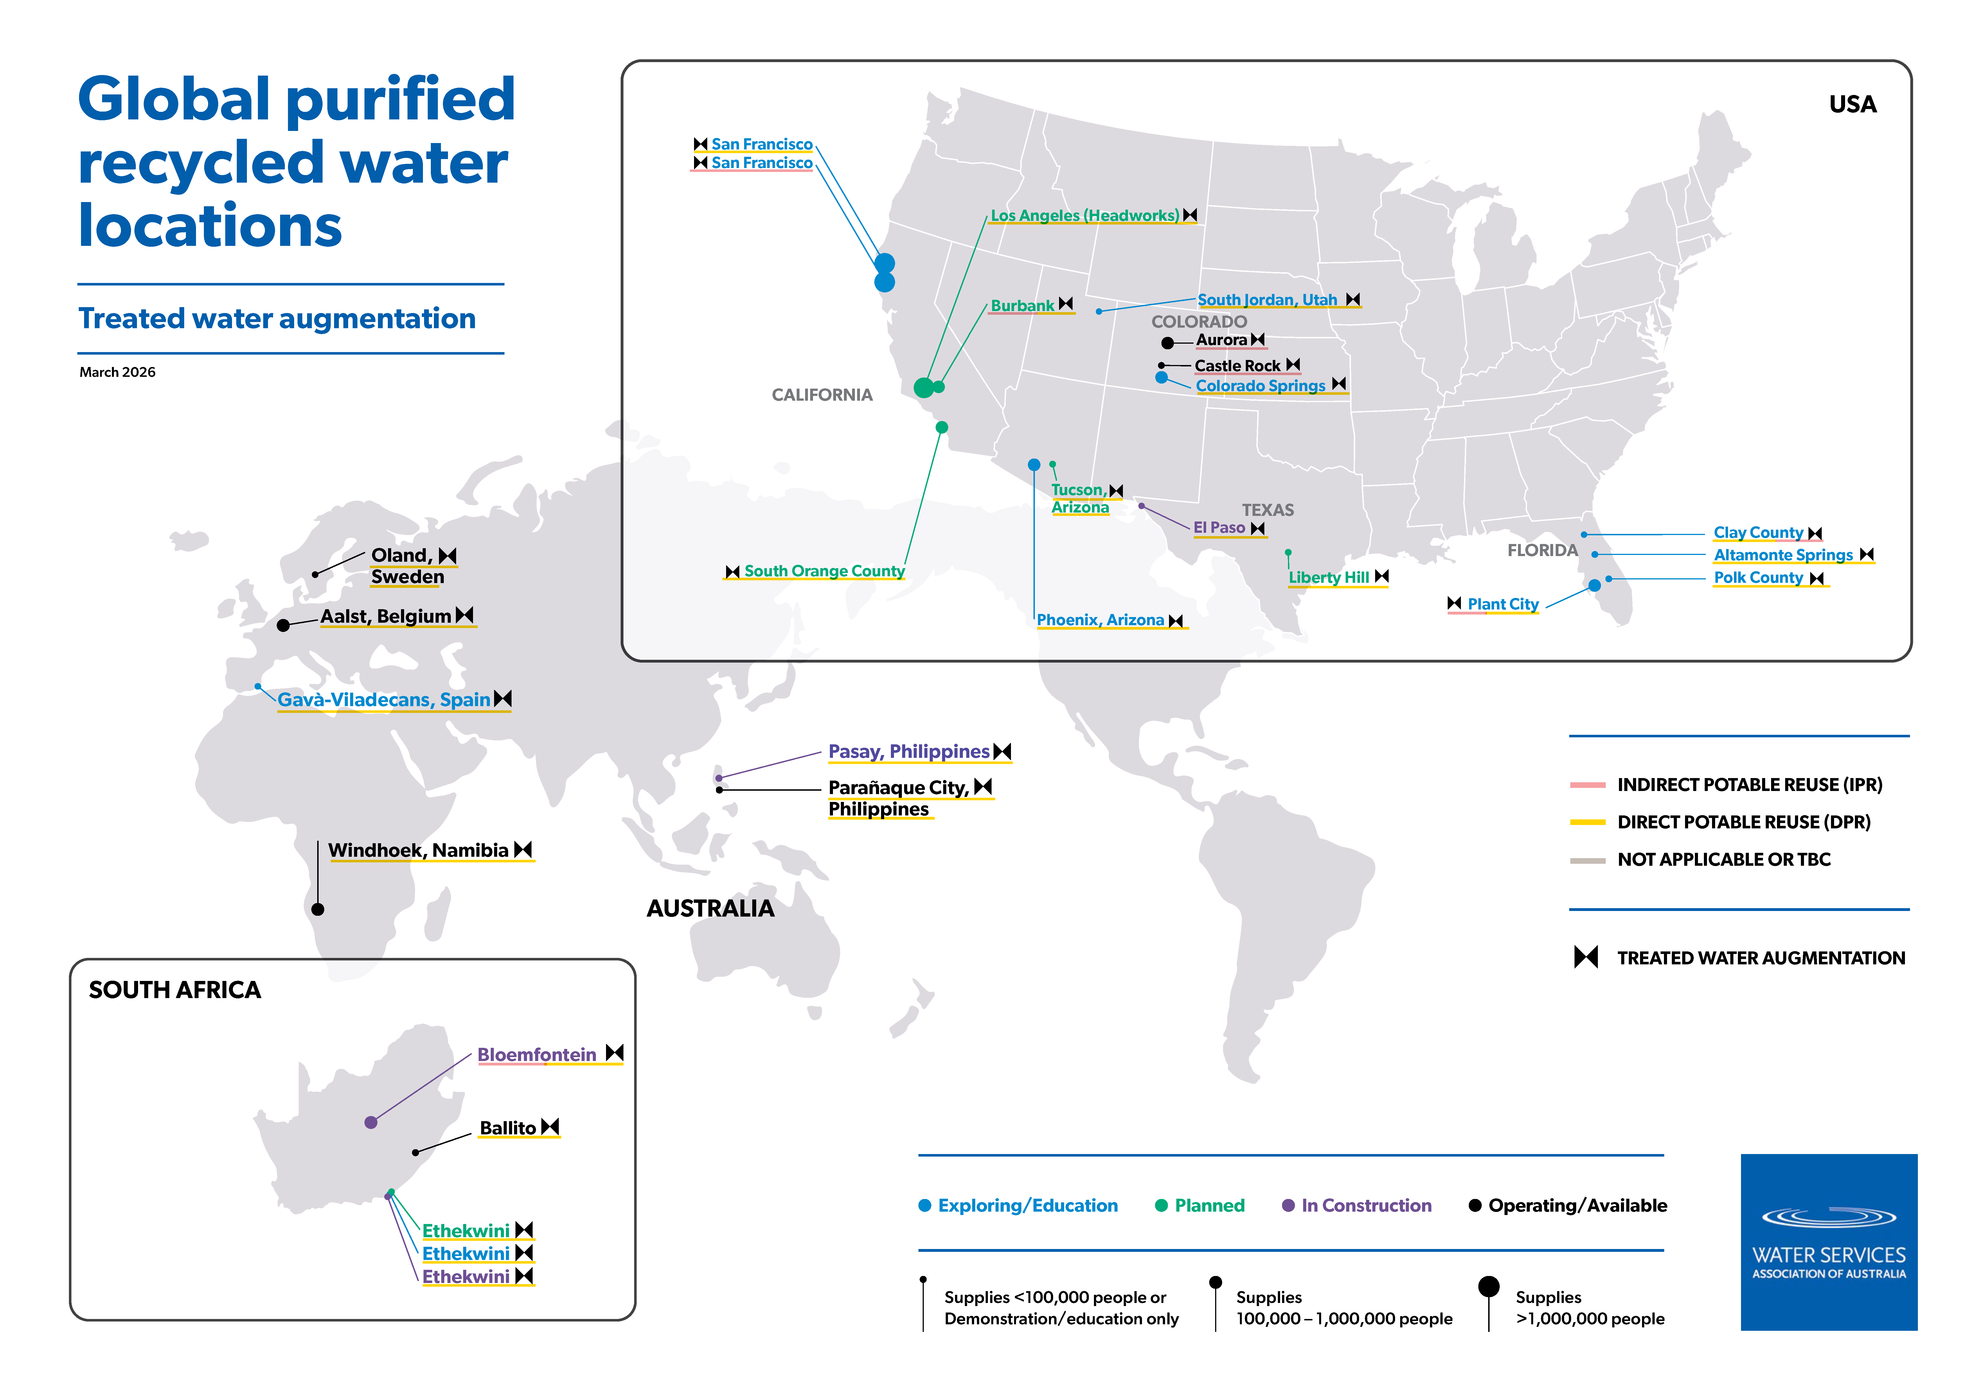

Slide 28
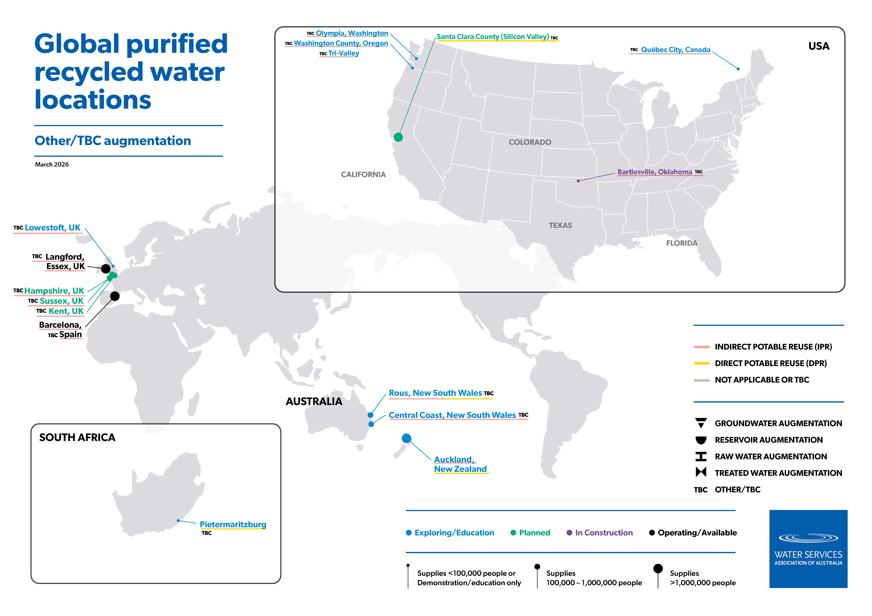

Slide 29
Maps by indirect + direct

Slide 30
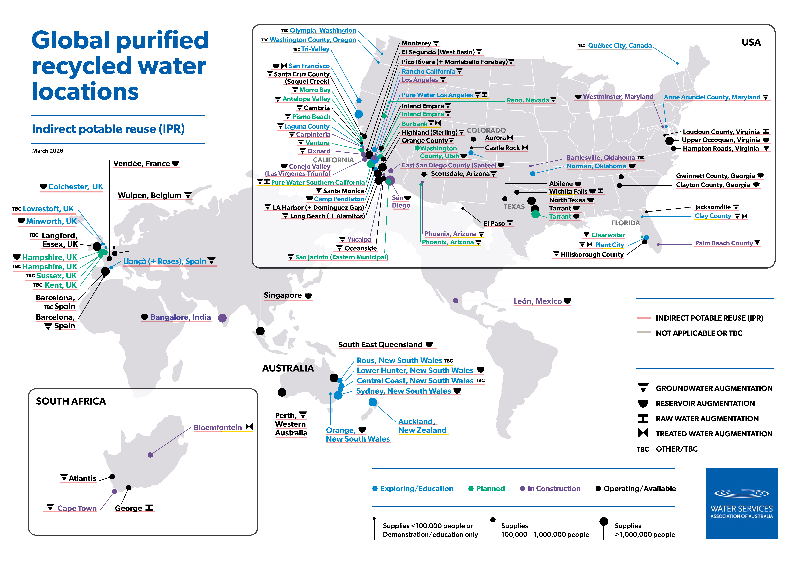

Slide 31
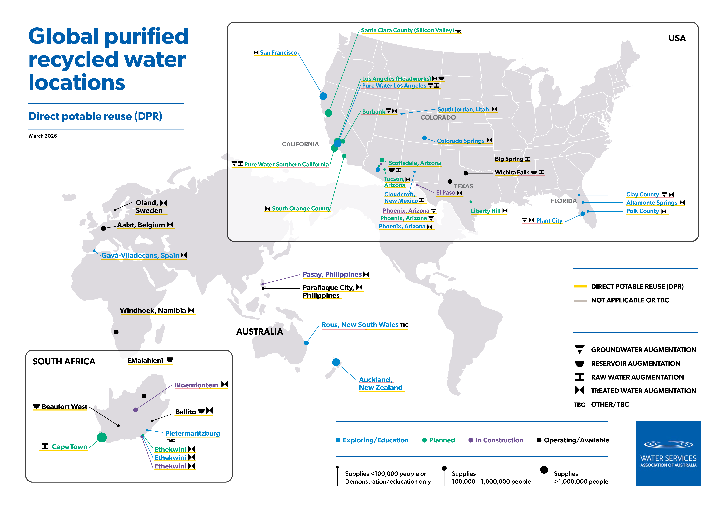

Slide 32
USA only map

Slide 33
